Slide 1
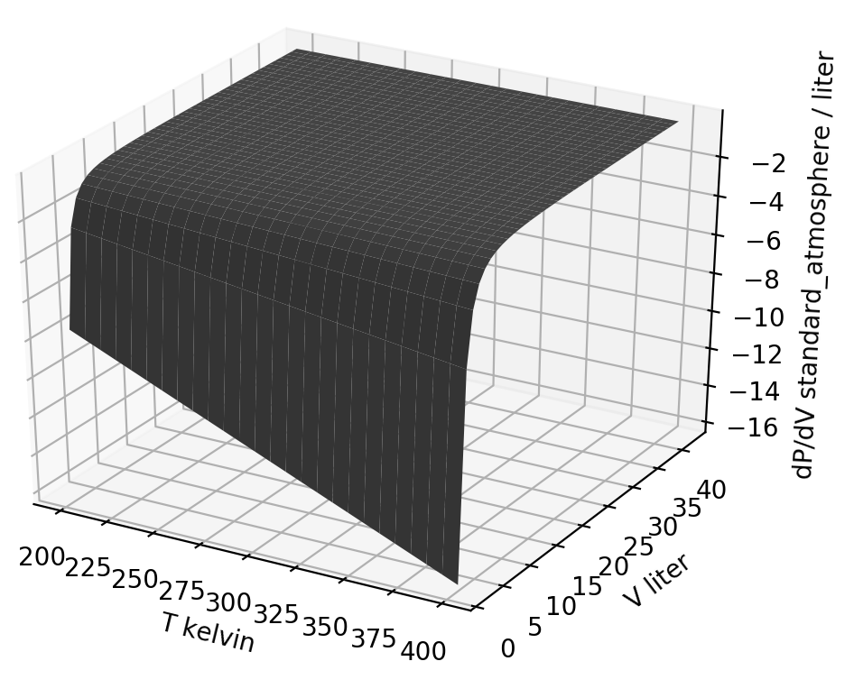
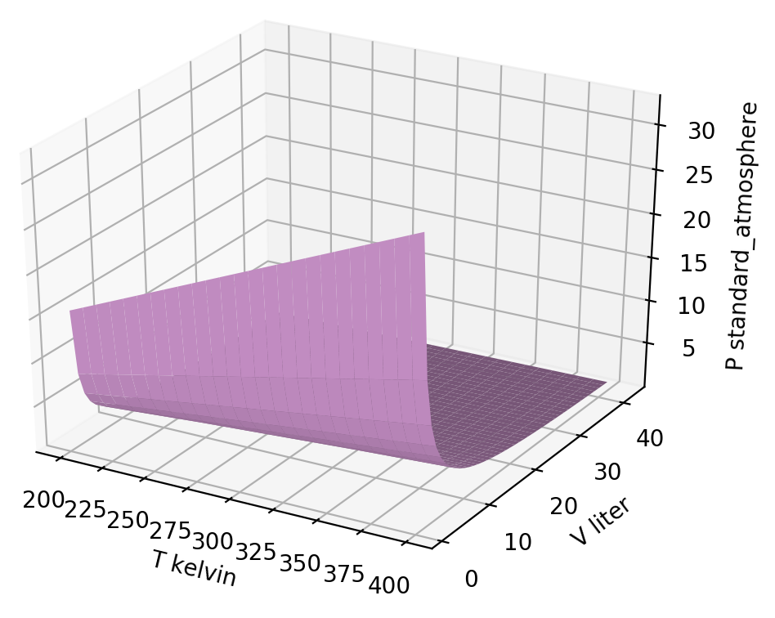
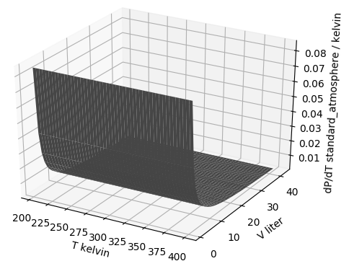



Thermodynamic surfaces of a gas - the big picture
${\left(\frac{∂P}{∂V}\right)}_{T}$
$$P\left(T,V\right)$$
${\left(\frac{∂P}{∂T}\right)}_{V}$

Slide 2
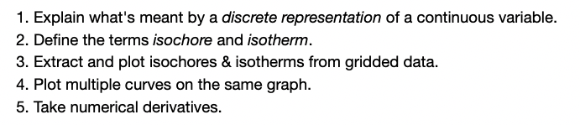
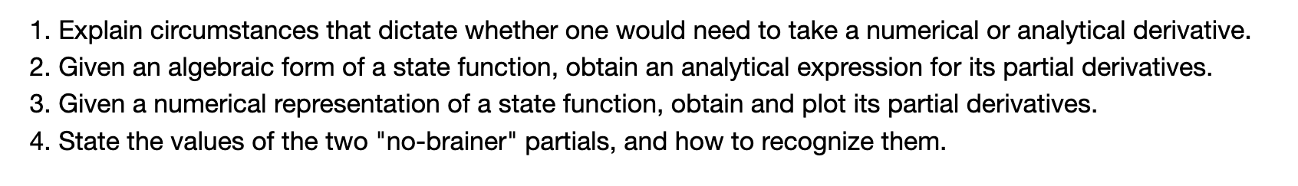
Thermodynamic surfaces of a gas - the goals
Learning Goals (Wednesday)
Learning Goals (Thursday)

Slide 3
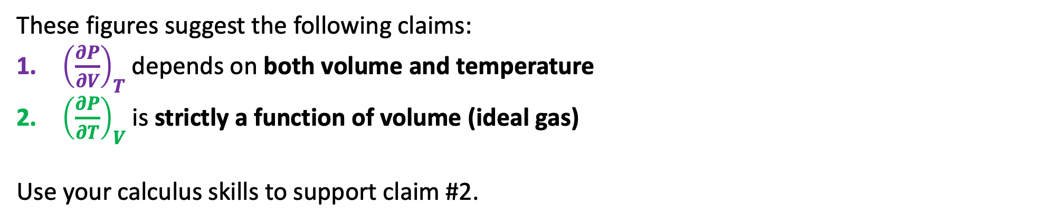
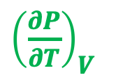
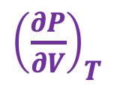
Analytical challenge #1: How ${\left(\frac{∂P}{∂V}\right)}_{T}$ and ${\left(\frac{∂P}{∂T}\right)}_{V}$ depend on temperature and volume
Here are slopes of the pressure of an ideal gas, depicted as thermodynamic surfaces:
${\left(\frac{∂P}{∂V}\right)}_{T}$
${\left(\frac{∂P}{∂T}\right)}_{V}$
These figures suggest the following claims:
${\left(\frac{∂P}{∂V}\right)}_{T}$ depends on both volume and temperature
${\left(\frac{∂P}{∂T}\right)}_{V}$ is strictly a function of volume (ideal gas)
Use your calculus skills to support claim #2.

Slide 4
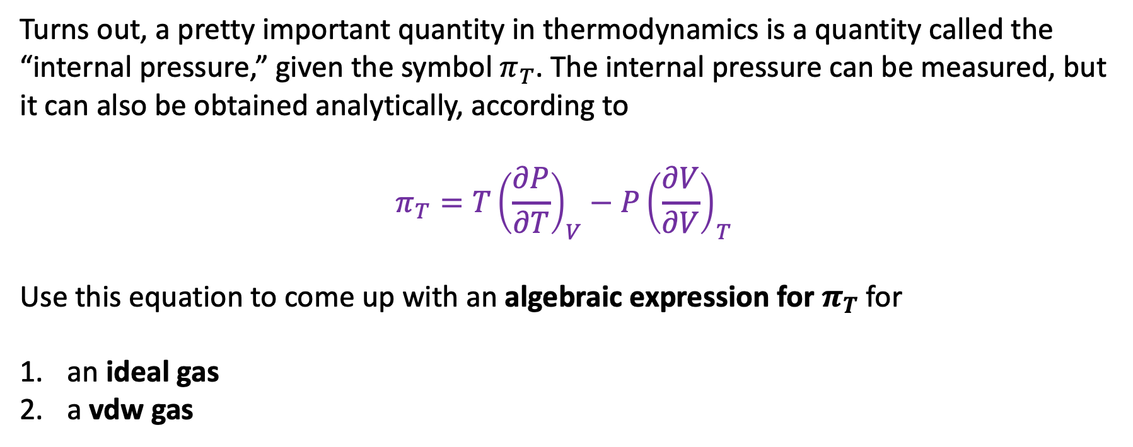
Analytical challenge #2: Derivation of $π_{T}$
Turns out, a pretty important quantity in thermodynamics is a quantity called the “internal pressure,” given the symbol $π_{T}$. The internal pressure can be measured, but it can also be obtained analytically, according to
$$π_{T}=T{\left(\frac{∂P}{∂T}\right)}_{V}−P{\left(\frac{∂V}{∂V}\right)}_{T}$$
Use this equation to come up with an algebraic expression for $π_{T}$ for
an ideal gas
a vdw gas

Slide 5
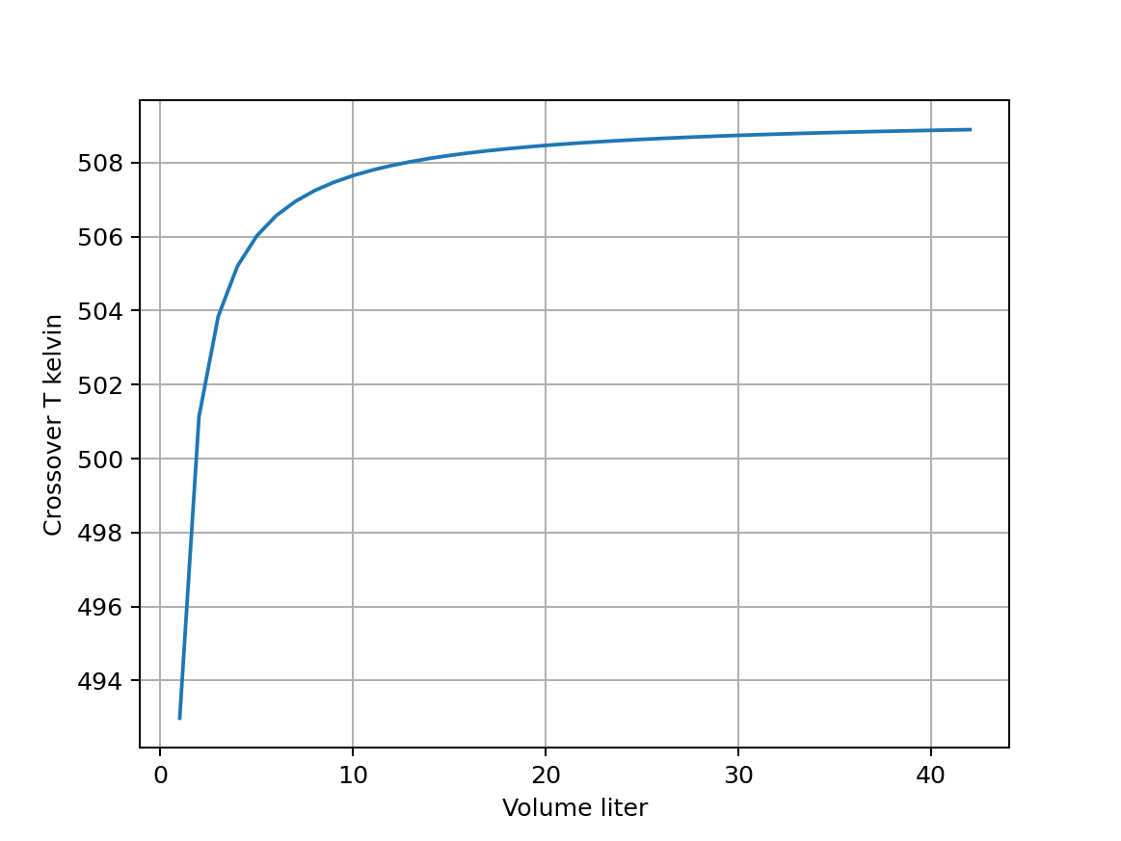
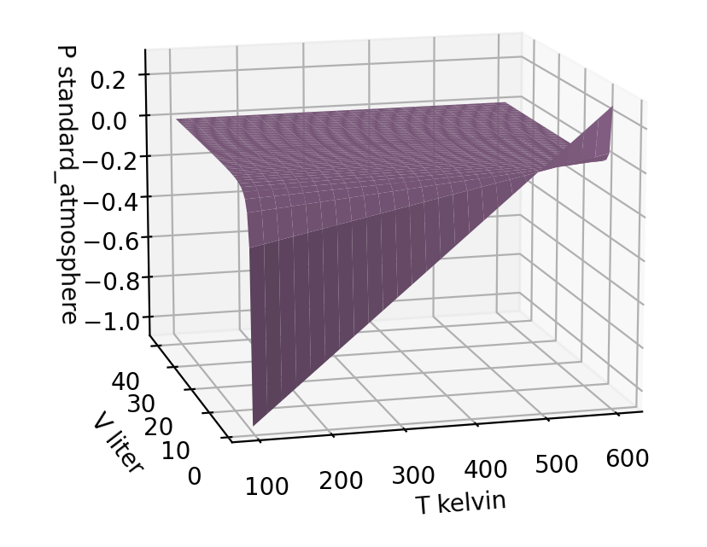
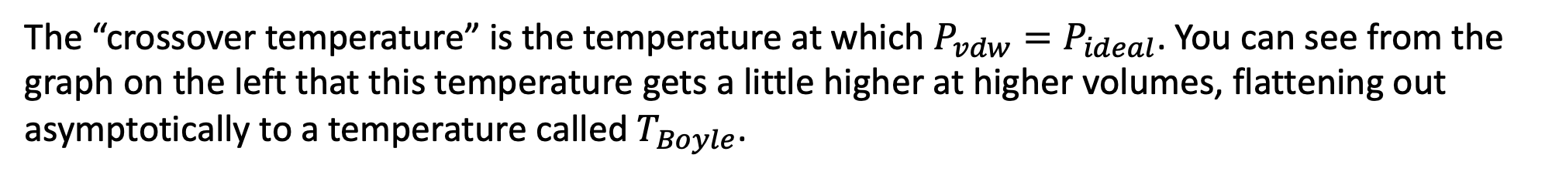

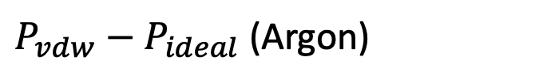
Analytical challenge #3: Return to the Boyle temperature
The “crossover temperature” is the temperature at which $P_{vdw}=P_{ideal}$. You can see from the graph on the left that this temperature gets a little higher at higher volumes, flattening out asymptotically to a temperature called $T_{Boyle}$.
$P_{vdw}−P_{ideal}$ (Argon)
$$T_{Boyle}$$

Slide 6
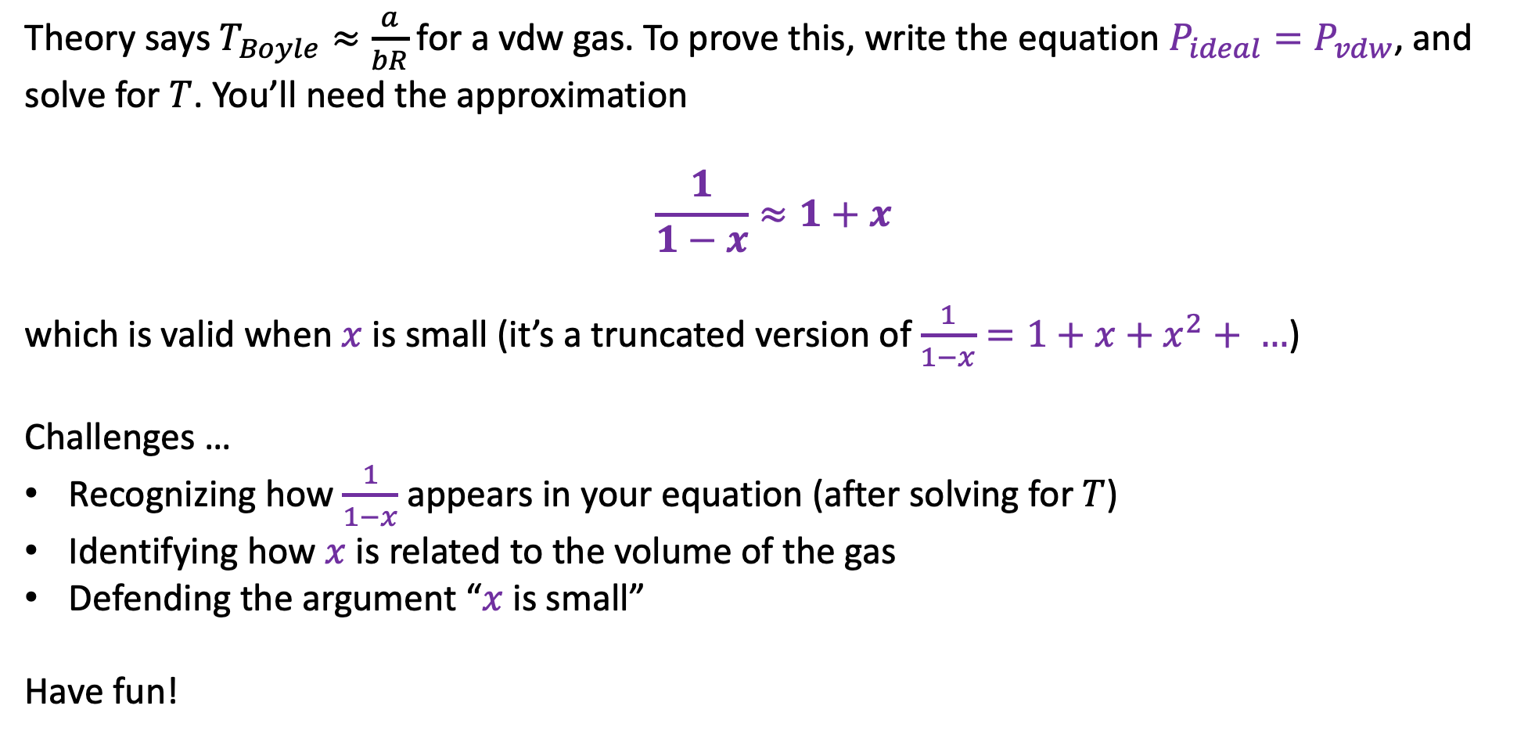
Analytical challenge #3: Return to the Boyle temperature
Theory says $T_{Boyle}≈\frac{a}{bR}$ for a vdw gas. To prove this, write the equation $P_{ideal}=P_{vdw}$, and solve for $T$. You’ll need the approximation
$$\frac{1}{1−x}≈1+x$$
which is valid when $x$ is small (it’s a truncated version of $\frac{1}{1−x}=1+x+x^{2}+ …$)
Challenges …
Recognizing how $\frac{1}{1−x}$ appears in your equation (after solving for $T$)
Identifying how $x$ is related to the volume of the gas
Defending the argument “$x$ is small”
Have fun!

